Slide 1

2026 Governmental Law Seminar
HUD Grants
February 28, 2026

Slide 2
HUD Grants
Stark County Regional Planning Commission is under contract with the Board of Stark County Commissioners to administer the CDBG and HOME grants
Both grants fall under the HUD office of Community Planning and Development (CPD)
Notes:
Emphasize for low-to moderate-income persons

Slide 3
Community Development
Block Grant
CDBG

Slide 4

CDBG Overview
The Community Development Block Grant (CDBG) Entitlement Program provides annual grants on a formula basis to states, cities and counties to develop viable urban communities by providing decent housing and a suitable living environment, and by expanding economic opportunities, principally for lower income persons.

Slide 5
CDBG Overview
The program was enacted when President Ford signed the Housing and Community Development Act of 1974
Was a response to rigid federal programs and provided more flexibility to local communities
Stark County became an Urban Entitlement County in 1975
Areas of the County participate in the Urban County except:
City of Massillon
City of Alliance
Village of Hills & Dales
Village of Wilmot
City of Canton

Slide 6
National Objectives
All activities funded with CDBG must meet one of the three National Objectives set forth by HUD
LMI Benefit
Slum/Blight
Aid in prevention of slum & blight
Urgent Need
Meet an urgent need
Benefit LMI persons

Slide 7
CDBG Application Process
Application Workshop/RFP Release
August
Applications due
October
October -December
Draft budget
Adopted budget
February
April
Program year begins
July
Application review/scoring
Notes:
Talk about receiving funding in December this year

Slide 8
CDBG Budget FY 2025

Slide 9
Eligible & Ineligible Activities
Many different eligible activities that fall into general categories:
Funded activities must be consistent with the County’s 5-year Consolidated Plan
Owner-Occupied Housing Rehabilitation
Infrastructure
Public Facilities (non-profit/gov’t owned)
Public Services (social services)
Economic Development – Technical Assistance
Notes:
Housing- rehabilitation, housing counseling, down payment assistance
Real property improvements- purchase or property, demolition, historic preservation
Public facilities- neighborhood facilities like parks, rec centers, homeless shelters, includes infrastructure improvements
Public services- meal programs, employment services, education programs
Economic Development – commercial or industrial land acquisition including needed infrastructure
Removal of architectural barriers is eligible in a governmental building, construction equipment can be eligible if leased

Slide 10
HOME Investment Partnerships
HOME

Slide 11

HOME Overview
The HOME Investment Partnerships Program (HOME) provides formula grants to participating jurisdictions, often in partnership with local nonprofit groups, to fund a wide range of activities including constructing and/or rehabilitating affordable housing for rent or homeownership or providing direct rental assistance to lower income residents.
HOME is the largest Federal block grant provided to state and local governments designed exclusively to create affordable housing for lower income households.

Slide 12
HOME Overview
George H.W. Bush signed the Cranston-Gonzalez National Affordable Housing Act in 1990 resulting in the creation of the HOME program
The County’s first HOME allocation was received in 1992
Stark County participates in a Designated Consortium with the cities of Alliance and Massillon to become an eligible “PJ” (Participating Jurisdiction)
The HOME funds are divided up among Alliance, Massillon and the County
The Cities provide input on how the funding should be used in their communities
All HOME funding must be used to support affordable housing activities

Slide 13
HOME Application Process
Application Workshop/RFP Release
August
Applications due
October/ November
November-January
Draft budget
Adopted budget
February
April
Program year begins
July
Application review
Notes:
FY25 received funding in December 2025

Slide 14
HOME Budget FY 2025

Slide 15
Community Housing Development Organization (CHDO)
Legal status
Organizational structure
Board composition
Capacity
Community Housing Development Organization
Type of non-profit organization that meets specific HUD criteria
CHDOs develop affordable housing for the community it serves
Federal regulations require a minimum of 15% of each annual allocation be set-aside for CHDOs

Slide 16


Eligible & Ineligible Activities
Acquisition for housing construction
New construction
Owner-occupied housing rehabilitation
Non-profit owned rental rehabilitation
Emergency shelter
Non-housing related developments
Rental assistance beyond 24 months

Slide 17
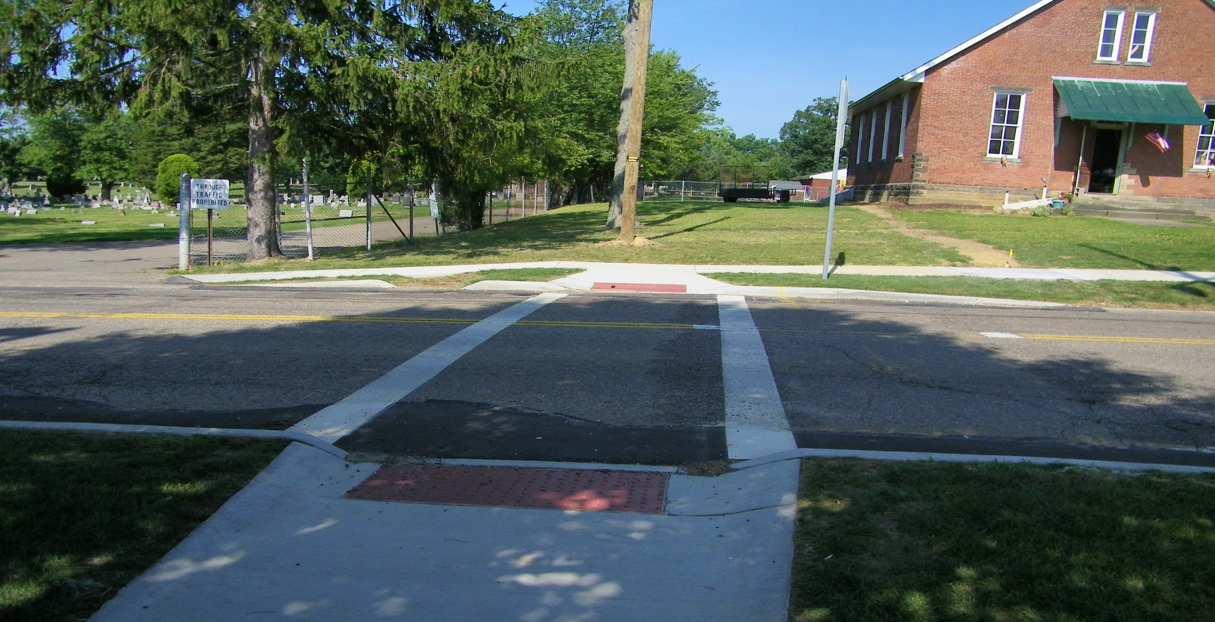
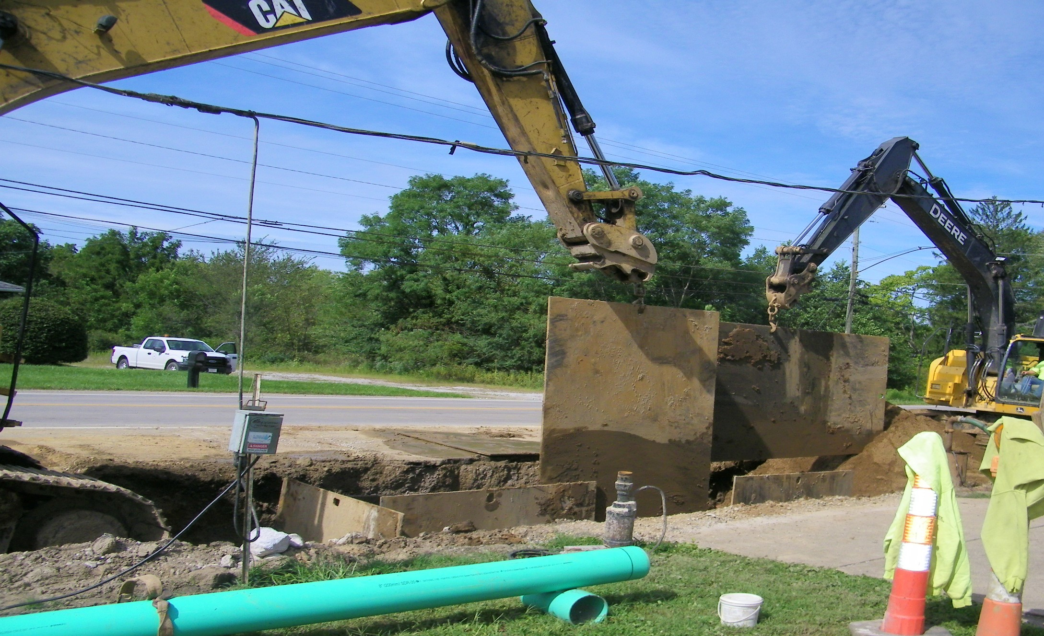
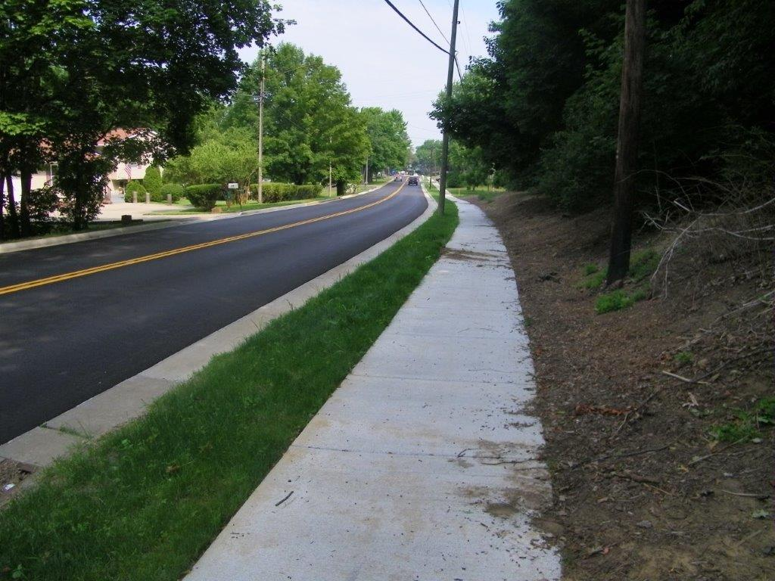
How Can HUD Funds Benefit My Community?
CDBG
investment
CDBG
investment
CDBG
investment
ADA curb ramps
Sanitary sewer lines
Waterline replacements

Slide 18
How Can HUD Funds Benefit My Community?
Single-Family Owner-Occupied Rehabilitation
Projects cannot exceed $25,000.00
Qualified households must be at or below 80% of the Area Median Income (AMI)
Grant/deferred loan to rehab homes and bring homes up to State of Ohio Residential Rehab Standards

Slide 19
Contact Information
Diane Sheridan, Chief of Community Development
dmsheridan@starkcountyohio.gov
330-451-7031
Lisa Snyder, Community Development Administrator
lcsnyder@starkcountyohio.gov
330-451-7247
Jill Ross, Housing Counselor
jeross@starkcountyohio.gov
330-451-7399

